Slide 1
PRACTICAL TEST – KMHFL
09/02/2022
Github link:

Slide 2
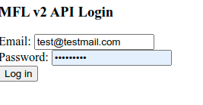
KMHFL LOG IN

Slide 3
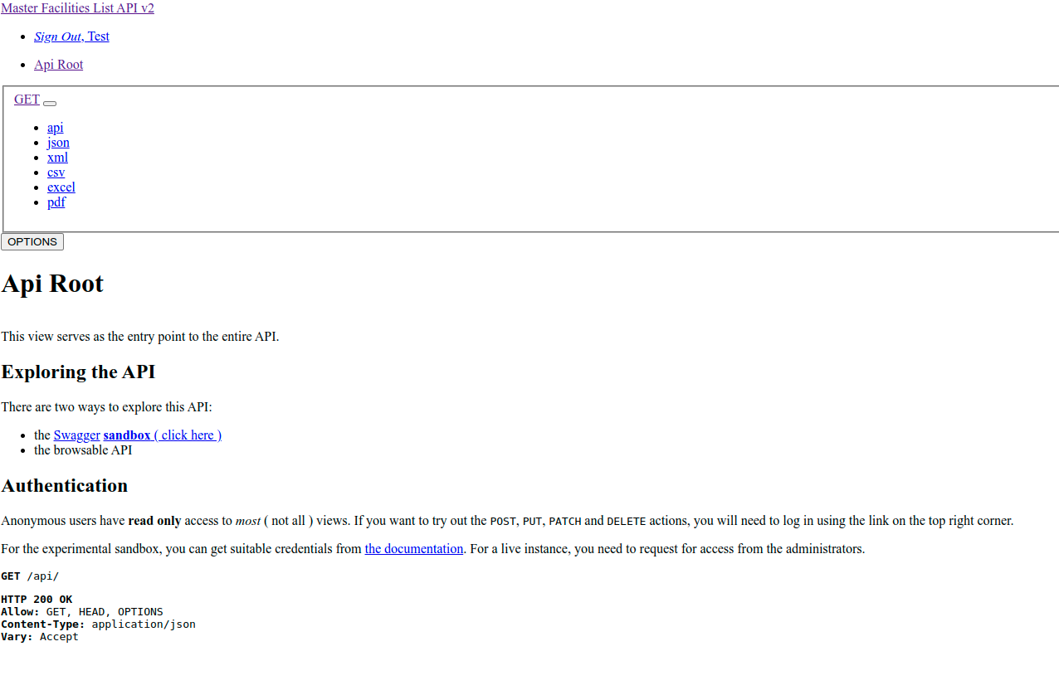

Slide 4
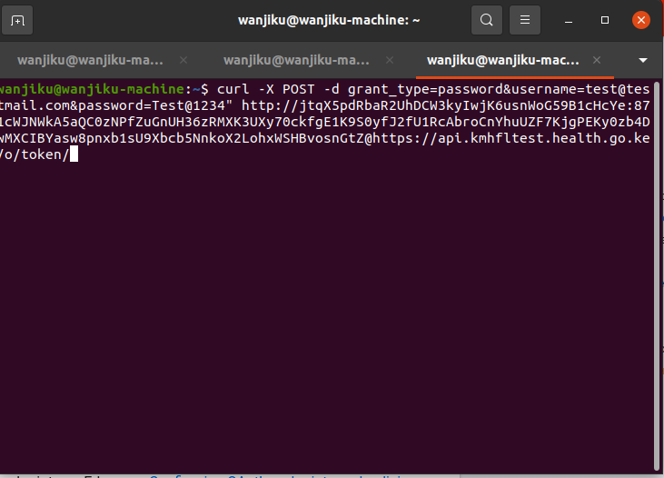
REQUEST ACCESS TOKEN

Slide 5
AUTHORIZATION

Slide 6
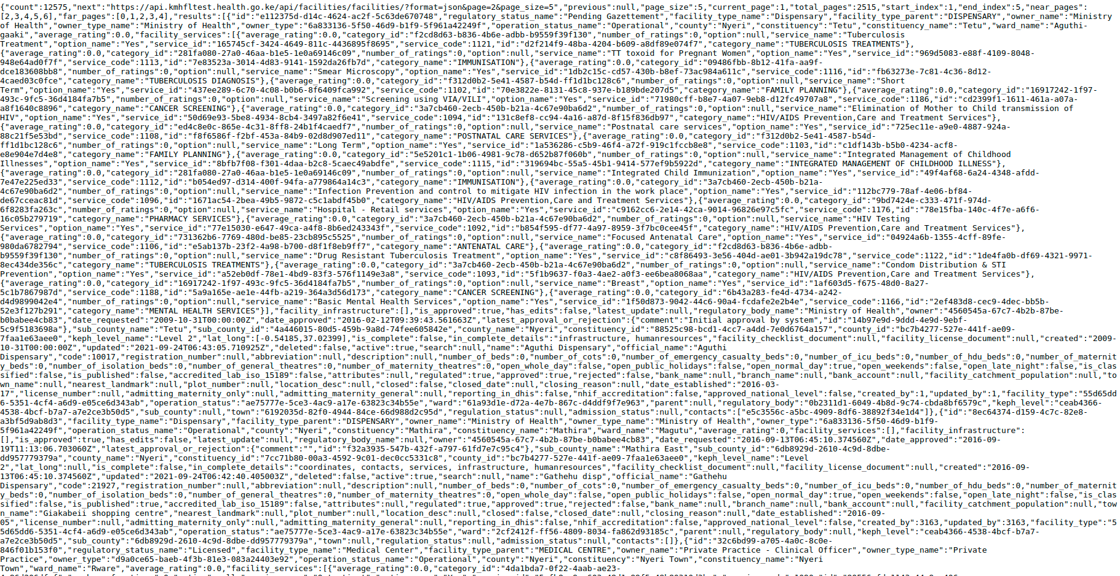
Json File

Slide 7
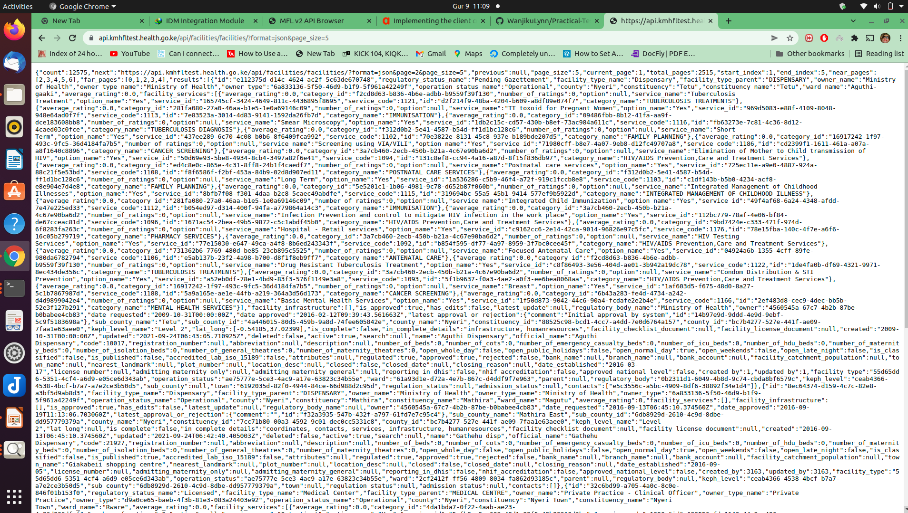

Slide 8
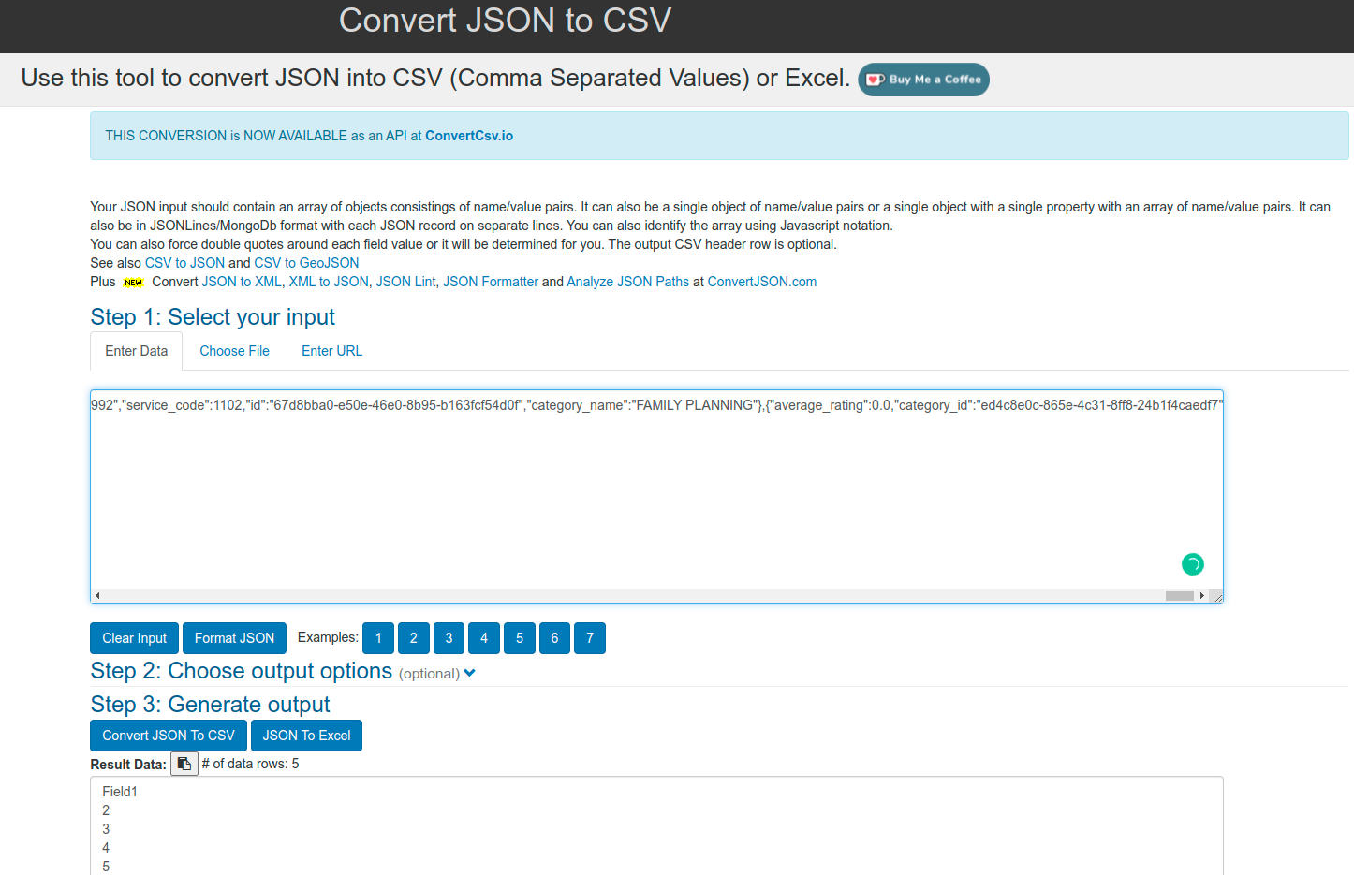
Step 3: Convert json file as csv

